Slide 1
Matlab tutorial and Linear Algebra Review
Today’s goals:
Learn enough matlab to get started.
Review some basics of Linear Algebra
Essential for geometry of points and lines.
But also, all math is linear algebra.
(ok slight exaggeration).
Many slides today adapted from Octavia Camps, Penn State.

Slide 2
Starting Matlab
For PCs, Matlab should be a program.
For Sun’s:
Numerical
Analysis and Visualization
Matlab 6.1

Slide 3
Help
help
help command
Eg., help plus
Help on toolbar
demo
Tutorial: http://amath.colorado.edu/scico/tutorials/matlab/

Slide 4
Matlab interpreter
Many common functions: see help ops

Slide 5
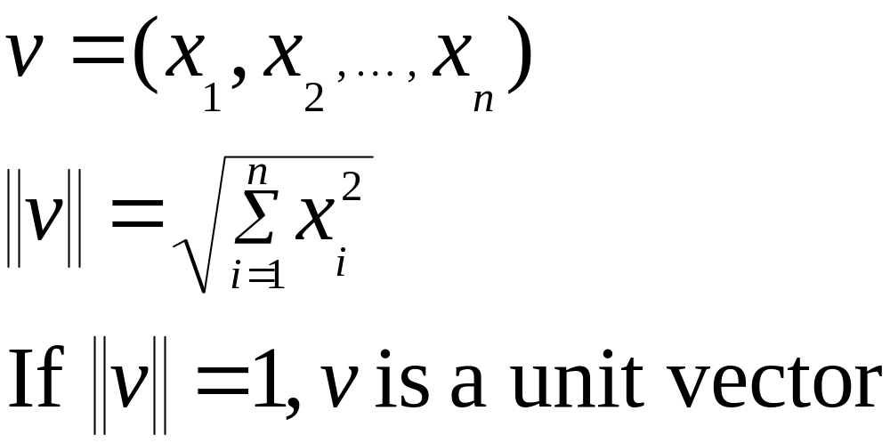
Vectors
Ordered set of numbers: (1,2,3,4)
Example: (x,y,z) coordinates of pt in space.

Slide 6
Indexing into vectors

Slide 7
Vector Addition
V+w
v
w

Slide 8
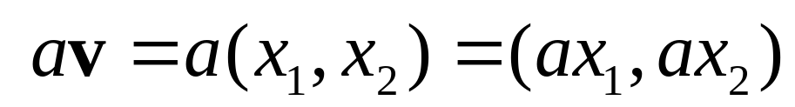
Scalar Product
av
v

Slide 9
Operations on vectors
sum
max, min, mean, sort, …
Pointwise: .^

Slide 10
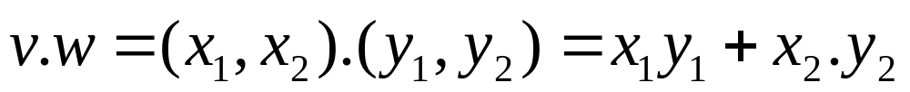
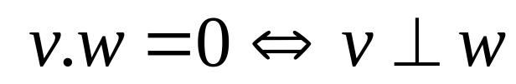
Inner (dot) Product
v
α
w
The inner product is a SCALAR!

Slide 11
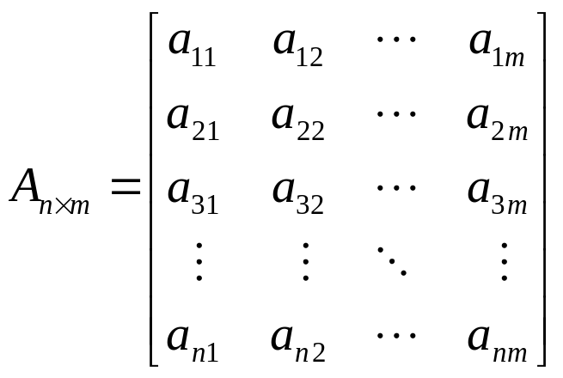
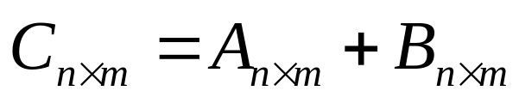
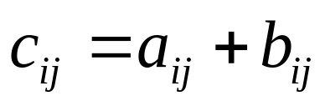
Matrices
Sum:
A and B must have the same dimensions

Slide 12
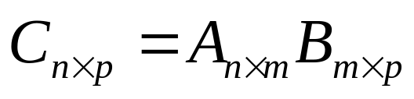
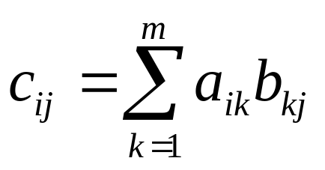
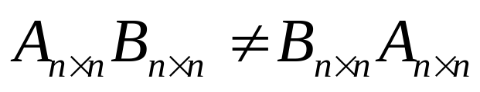
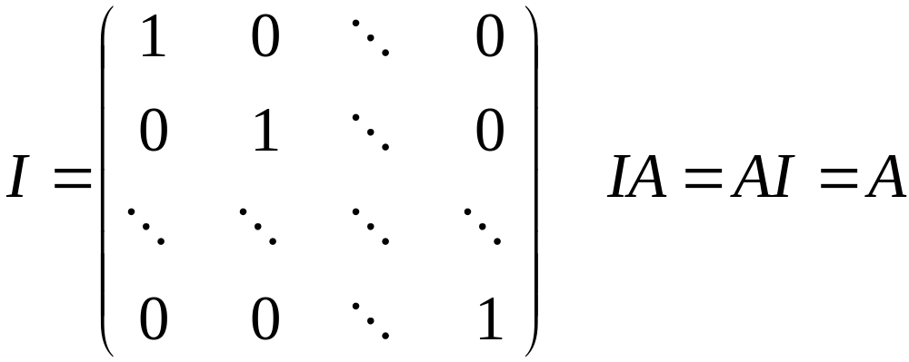
Matrices
Product:
A and B must have compatible dimensions
Identity Matrix:

Slide 13
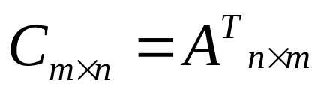
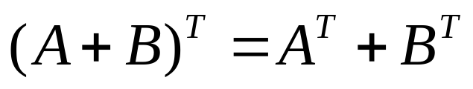
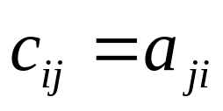
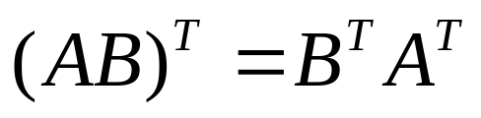
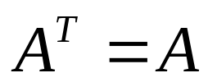
Matrices
Transpose:
If
A is symmetric

Slide 14
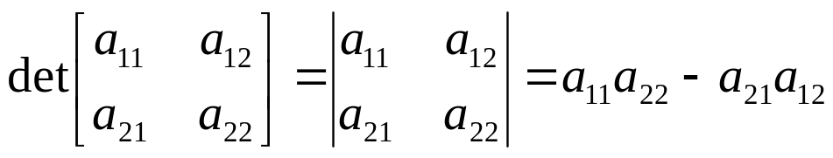
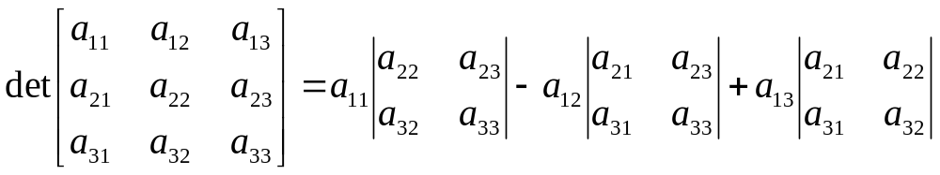
Matrices
Determinant:
A must be square

Slide 15
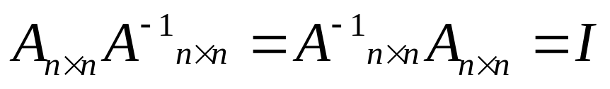
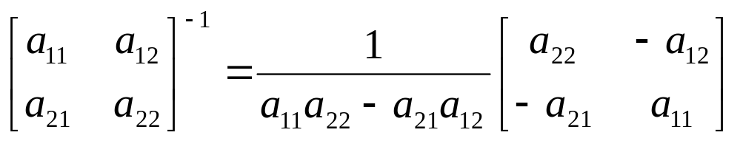
Matrices
Inverse:
A must be square

Slide 16
Indexing into matrices

Slide 17
Euclidean transformations

Slide 18

2D Translation
P’
t
P

Slide 19
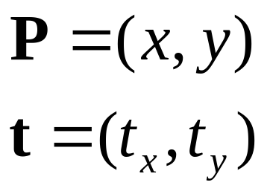
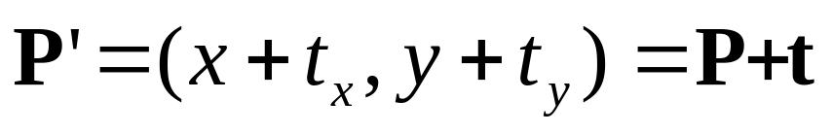
2D Translation Equation
P’
t
ty
P
y
x
tx

Slide 20
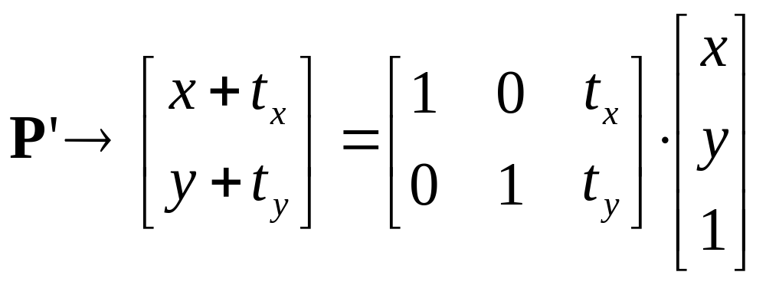
2D Translation using Matrices
P’
t
ty
P
y
t
P
x
tx

Slide 21
Scaling
P’
P

Slide 22
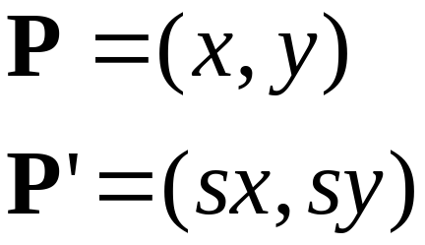

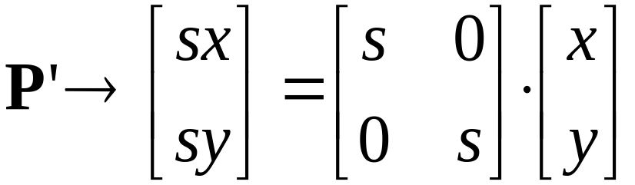


Scaling Equation
P’
s.y
P
y
x
s.x

Slide 23
Rotation
P
P’

Slide 24
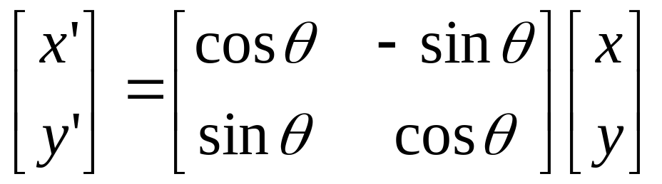

Rotation Equations
Counter-clockwise rotation by an angle θ
P’
Y’
θ
y
P
x
X’

Slide 25
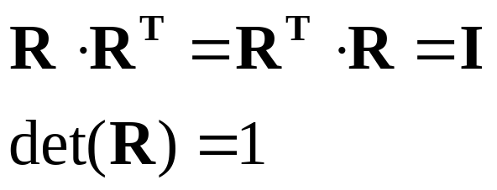
Degrees of Freedom
R is 2x2
4 elements
BUT! There is only 1 degree of freedom: θ
The 4 elements must satisfy the following constraints:

Slide 26
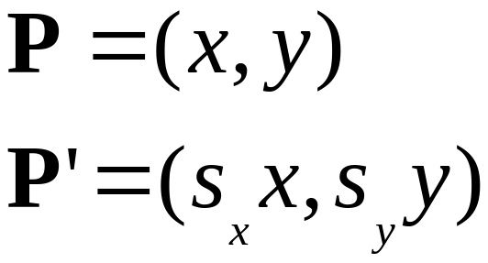
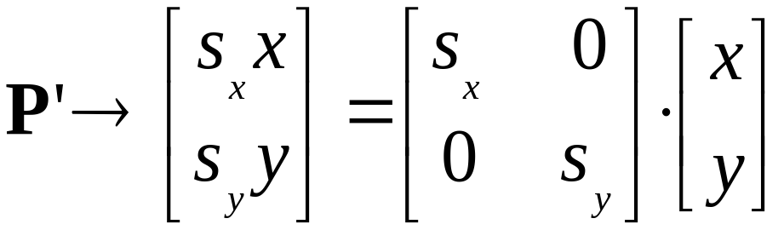
Stretching Equation
P’
Sy.y
P
y
x
Sx.x

Slide 27
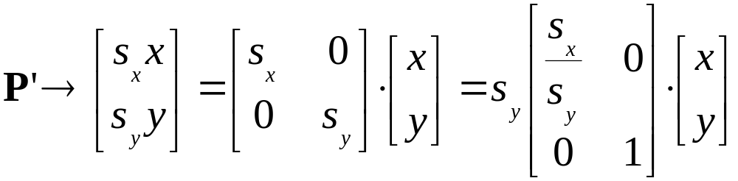
Stretching = tilting and projecting
(with weak perspective)

Slide 28
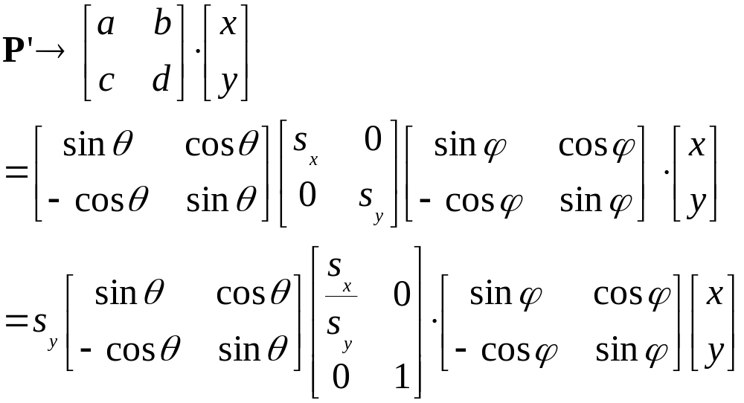
Linear Transformation
SVD

Slide 29
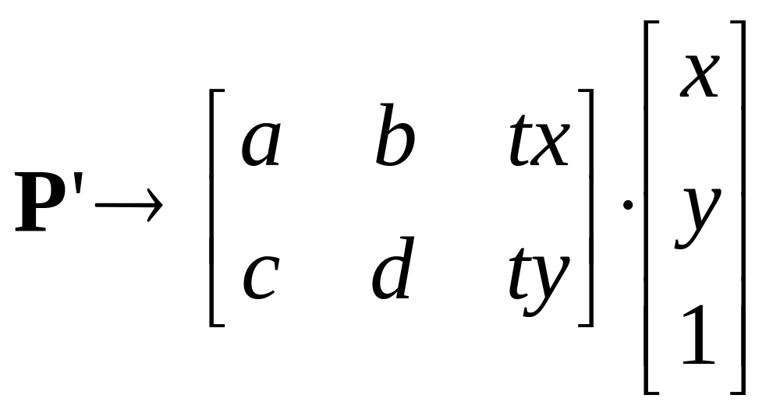
Affine Transformation

Slide 30
Files

Slide 31
Functions
Format: function o = test(x,y)
Name function and file the same.
Only first function in file is visible outside the file.

Slide 32
Images

Slide 33
Debugging
Add print statements to function by leaving off ;
keyboard
debug and breakpoint

Slide 34
Conclusions
Quick tour of matlab, you should teach yourself the rest. We’ll give hints in problem sets.
Linear algebra allows geometric manipulation of points.
Learn to love SVD.

